Slide 1

Colombia for emigrants
Autarchy sas, medellin and santa marta
www.autarchy.co
Autor: Roger schmidt
December 2023

Slide 2
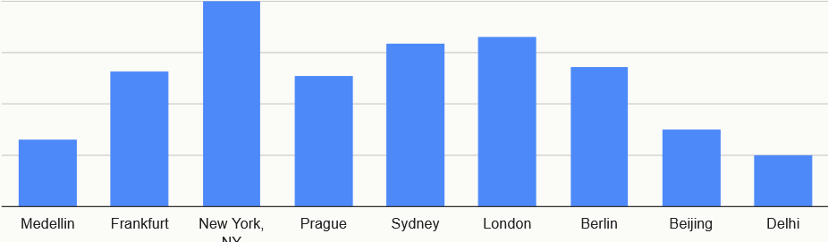
Why Colombia: Costs of living
Low cost of living (see link comparison Frankfurt am Main, Germany / Medellin)
https://www.numbeo.com/cost-of-living/compare_cities.jsp?country1=Germany&country2=Colombia&city1=Frankfurt&city2=Medellin
Living in Medellín for 2,080 euros is like living in Frankfurt for 4,500 euros (source: Numbeo see link). Medellín is one of the most expensive places in Colombia, like Munich in Germany.

Slide 3
WHY Colombia: Climat
Colombia has all climate zones. If you like it a little warmer, the coastal region on the Caribbean Sea (Santa Marta, Cartagena de Indias, Barranquilla, Palomino etc.) is the right region for you with 30-38 degrees.
The beautiful coffee region (Armenia, Pereira and Manizales) and Medellín are considered a region of year-round spring. A climate of 23-28 degrees during the day is very pleasant. It doesn't need heating or air conditioning.
For people who would like something a little fresher, Rionegro, at 2,125 meters and about 1 hour from Medellín, is a suitable domicile.

Slide 4
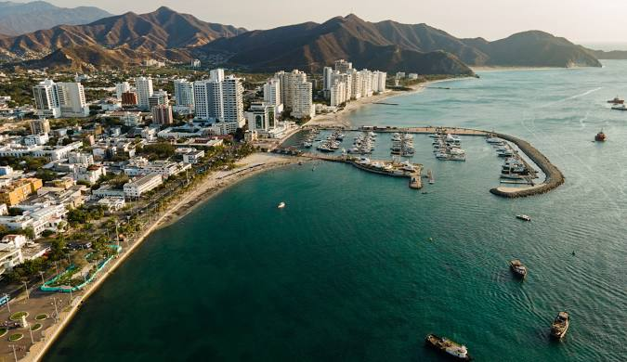
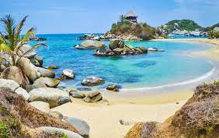
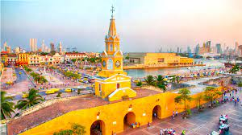
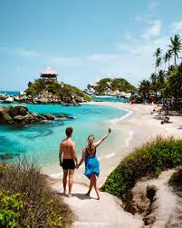
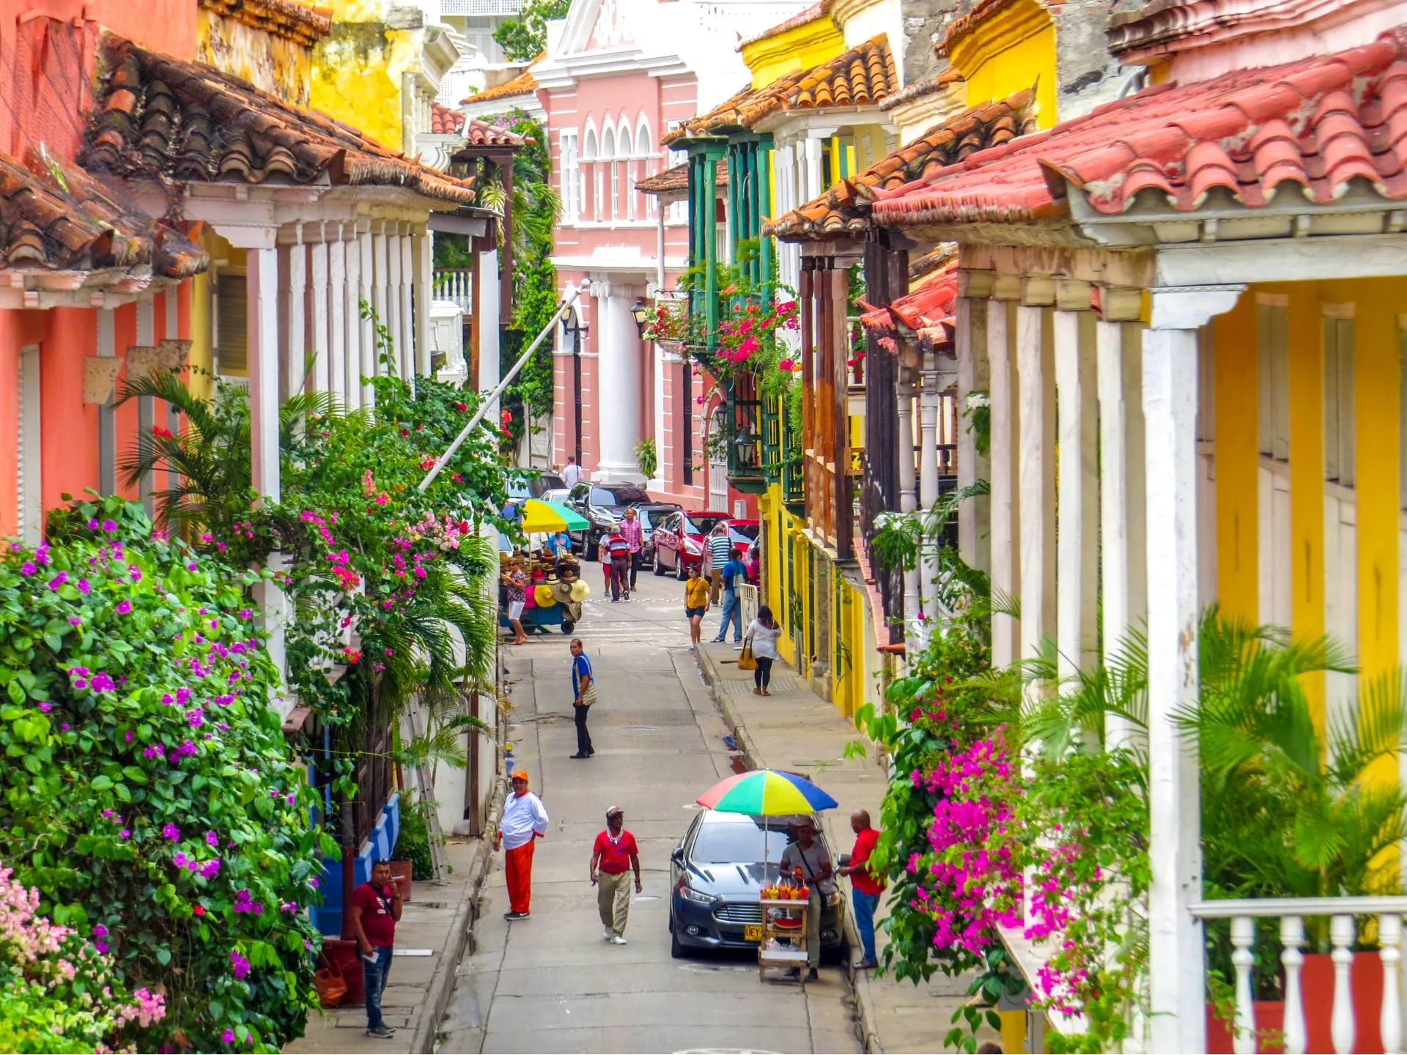
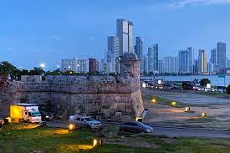
COAST REGION

Slide 5
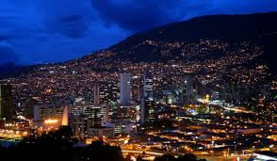
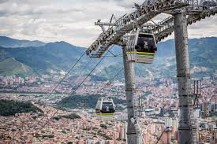
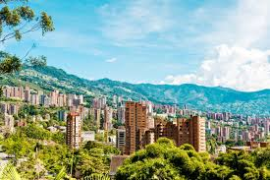
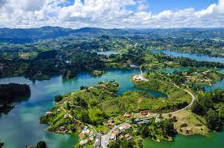
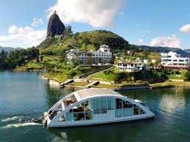
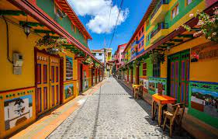
Medellín AND rEGION

Slide 6
WHY COLOMBIA: CULTUR
Colombians are very friendly and helpful people. Even if you only speak a few words of Spanish, the Colombians are happy about it and you can't speak Spanish without making mistakes without being embarrassed. These are ideal conditions for learning a language. You can book private lessons for around 8-10 euros in order to quickly make initial progress in the Spanish language.
The country is very Catholic and is reminiscent of Central Europe in the 80s, when older and pregnant people were offered seats on the bus; this is still happening here. People also greet each other when they get into an elevator and are very considerate and respectful.
The Latin American joy of life must of course be mentioned. There is a lot of dancing to salsa and other rhythms and you can quickly make contact with the local population; Europeans enjoy a particularly good reputation among Colombians.
The food depends a lot on the region. In larger cities you can easily find international cuisine. Pizza, sushi and a barbecue are available practically everywhere.
As a foreigner, you don't have to constantly worry about being ripped off like in other countries. There are usually no surcharges for foreigners, this makes life a lot more relaxed, a taxi switches on the taxi meter and you pay the same price as locals.
Colombians are also very clean and tidy. The public toilets are in better condition than in Central Europe. Large and modern shopping malls leave nothing to be desired.
It's very common to rent a finca and head to the country for a long weekend. With around 20 free assemblies per year, it is used frequently. You can then spend a relaxing weekend by the pool with friends and acquaintances.

Slide 7
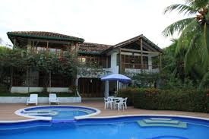
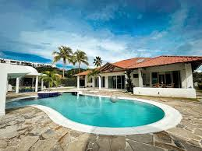
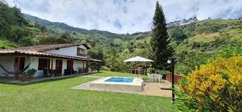
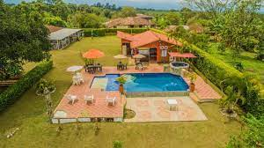
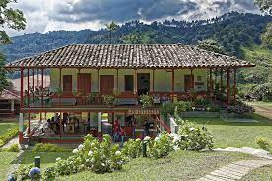
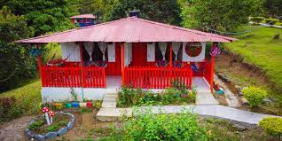
Fincas

Slide 8

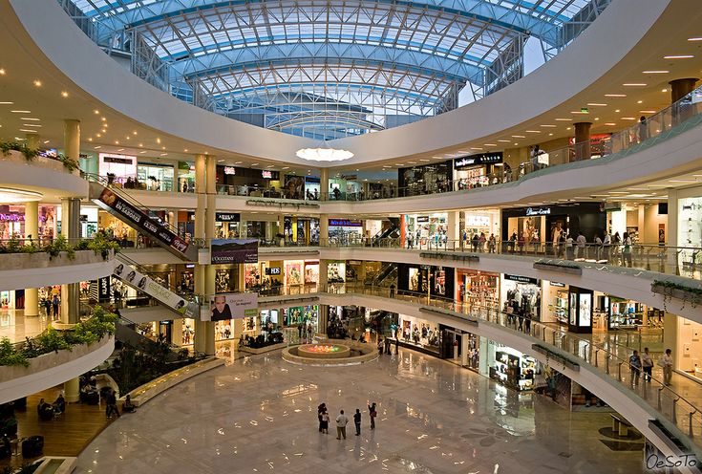
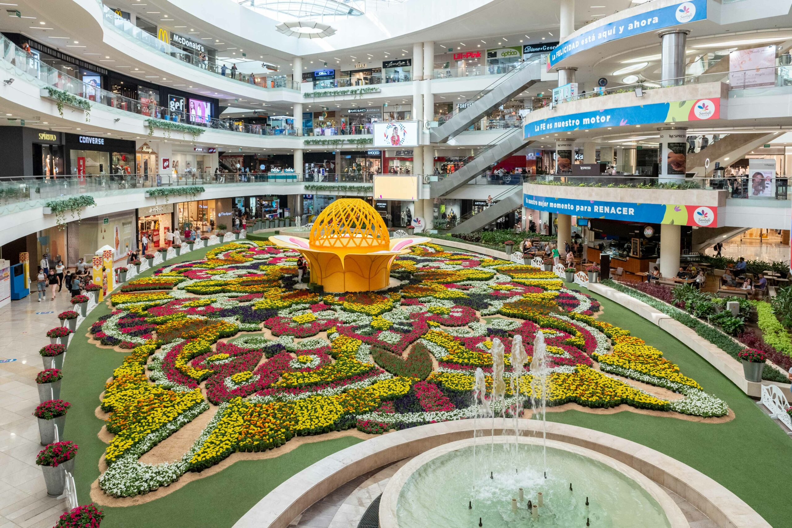
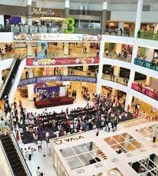
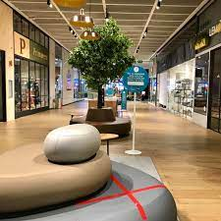
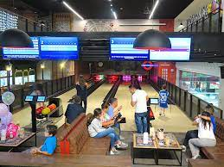
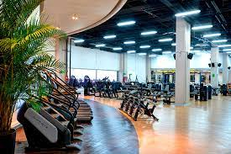
Shopping mall´s / Fitness Studio / Bowling

Slide 9
Negative aspects or things you don't do
There are still areas in Colombia that are considered dangerous and are. However, these are very remote regions and areas of the Amazon that you normally don't include in your travel plans anyway. Thoughtless travel to the most remote areas is not advisable. Everyone in Colombia knows what the “no go areas” are and so it is easy to avoid putting yourself in this danger.
Like everywhere else in the world, big cities also have neighborhoods that you should avoid, especially at night. These parts of the city are all well known and there is usually nothing to do there, especially not at night. Colombia's major cities are generally safe, but as always, it is important not to be naive and careless.
Colombian women are considered pretty and spirited. In Colombia it is still easy to speak to someone in a friendly manner and invite them for coffee. You can just get to know someone. However, Tinder is full of prostitutes who will drug you and rob you. It is a “no go” to take someone into your home that you don’t know well. In Colombia you go to a motel, it's not rude, it's common. We don't recommend using Tinder, especially because you can still get to know someone the traditional way.
Even if you are annoyed, you should try to remain calm. Yelling, being loud or insulting someone is not acceptable in Colombia. It is seen as complete disrespect and can also lead to escalation of a situation. If you stay calm and don't start becoming aggressive, any dispute can usually be resolved.
Demonstrating to everyone that you have money and walking around with a wallet full of hundreds of dollars and then showing it when you pay at the checkout is also a “no go”. At best, you make yourself a target for pickpockets.
Personal hygiene and clean clothes are important to Colombians and they attach great importance to it. In the cities you wear jeans and sneakers and a t-shirt or shirt. Bathing shoes and sandals belong on the beach and not in the city. Strolling around cities without your upper body is also a “no go”.
Running a business in Colombia is a lot more difficult than in Germany or Switzerland. Finding good staff and concluding deals with Colombians requires a lot of patience and nerves. It's possible, but not for everyone.

Slide 10
Visa-typ (V-VisA)
There are basically three types of visa: V, M and R
Type V: The V stands for visitor. It is not possible to apply for permanent residence with this visa. However, you receive a Colombian identity card and can use it to easily open a bank account, apply for an internet connection or use it to identify yourself in the country. The visa is usually issued for one year. You can apply for a new visa indefinitely about 2 months before it expires.
Student visa
Digital nomad visa
Work visa, journalist, missionary, volunteer…
The costs including service costs through Autarchy SAS amount to between 450 and 650 EUR, depending on the visa.

Slide 11
Visa-typ (M-VisA)
There are basically three types of visa: V, M and R
The type M: The M stands for migrant. With all migrant visas there is the possibility of obtaining permanent residence (lifelong) after 2 - 5 years (depending on the visa) and then also obtaining citizenship. To obtain citizenship, the applicant's knowledge of language, geography, the constitution and history are tested, among other things. However, if you have a Colombian university degree, this exam will be waived.
With the migrant visa you also receive a Colombian identity card, which serves as local identification document. You can open a bank account, conclude rental agreements, travel within the country and, for example, identify yourself at police checks. This identity card is the size of a credit card and can easily be carried in a wallet. Typical migrant visas are:
Pensioner visa, investor visa (purchasing real estate or setting up a company or partner), marriage visa, parents...
The costs including service costs through Autarchy SAS amount to between 550 and 750 EUR, depending on the visa
In principle, the visa is granted for 1 year when you apply for the first time. In the following years, the visa can, but does not have to, be granted for up to 3 years.

Slide 12
ViSA typ (R-ViSA)
There are basically three types of visa: V, M and R
The Type R: The R stands for Resident. After two to five years, depending on the M visa, permanent residence for life can be applied for. The visa must be renewed every 5 years.
The first R visa costs around 800 euros including our fee. Renewals then only cost around 400 euros every 5 years including our fee.
As a holder of an R visa, you can apply for naturalization after 2 - 5 years - but this can take a good 1 to 2 years. Examinations (constitution, language, history and geography) are required. However, if you have a Colombian university degree, the state waives the exams.

Slide 13
COMPANY FORMATION
In order to obtain a visa by setting up a company, an investment of around 140,000,000 COP (approximately 27,000 EUR) is necessary.
The money must be paid into the company, but is freely available to the shareholder. This means that the money is not blocked and can be freely disposed of by the shareholder.
All costs for setting up a company, including registration in the commercial register, amount to approximately EUR 1,500.
Bookkeeping and tax returns including VAT, invoicing, payroll and annual financial statements for around 15 transactions per month amount to around EUR 1,100 per year.

Slide 14
REAL ESTATE MARKET
Foreigners are allowed to purchase residential property and land - there are no restrictions.
However, we always recommend having the land register titles checked. Autarchy SAS offers this service.
The residential areas are divided into so-called estratos (0-6). The higher the estrato, the higher the quality of living in the neighborhood. The additional costs (gas, water and electrical energy) also depend on the estrato. The higher the estrato, the higher the additional costs - it is, so to speak, an indirect tax, the rich subsidize the poor. We only recommend apartments from Estrato 3 or 4. The purchase or rental prices are based on the Estrato.
In principle, apartments are available from 60,000 euros, and as everywhere else, the prices are open.
Here is a link to get an idea of ​​the price:
https://www.properstar.de/kolumbien/medellin-l2/kaufen/wohnung

Slide 15
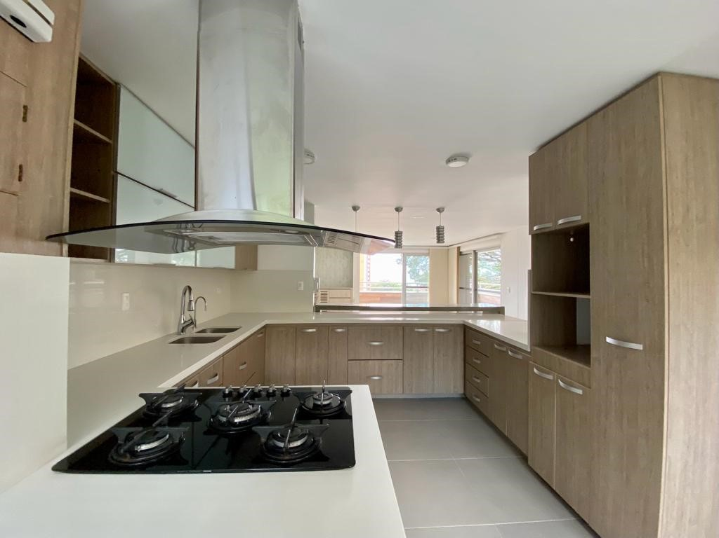
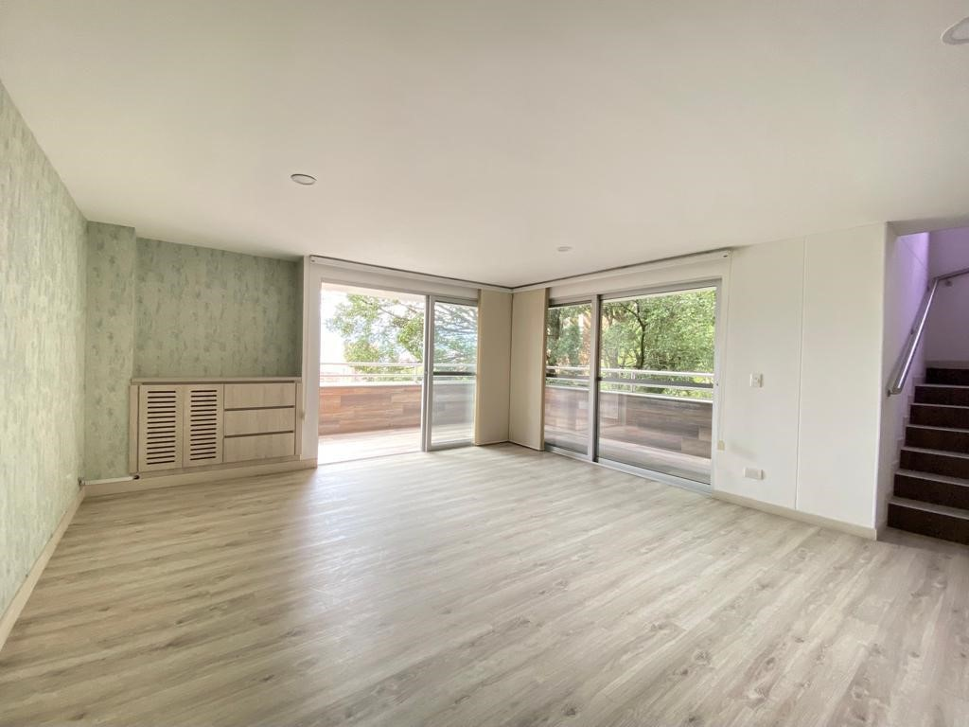
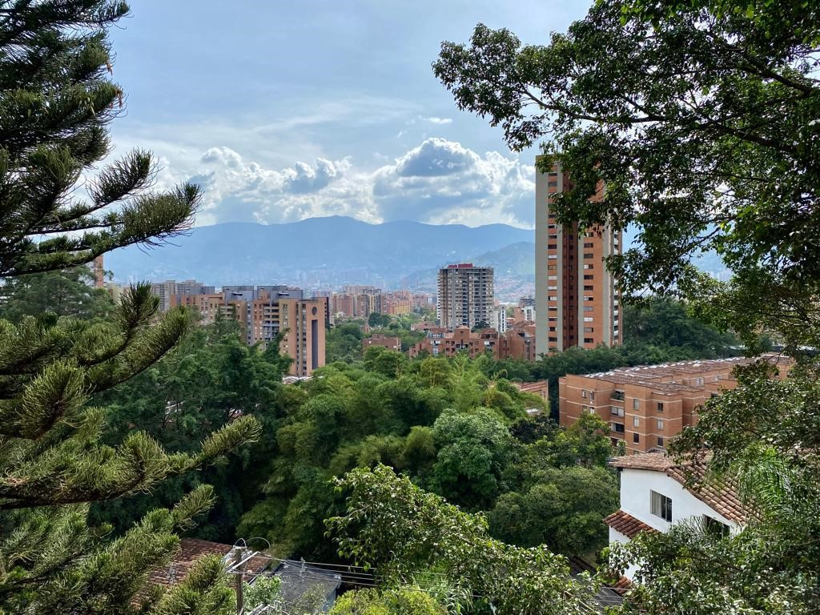
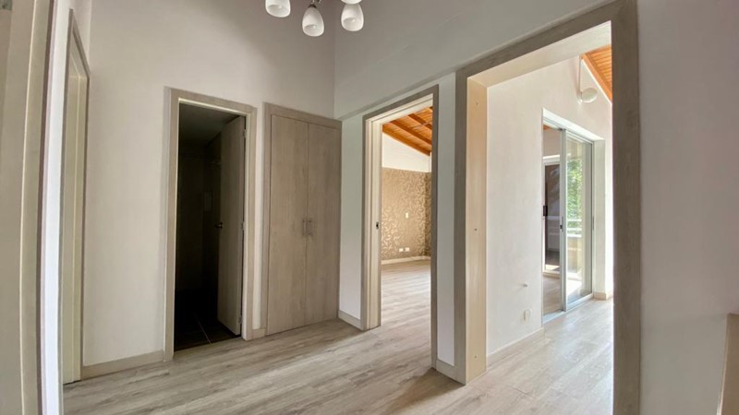
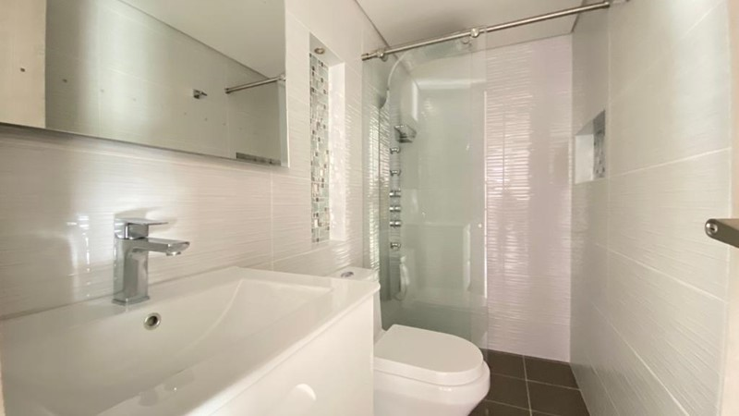
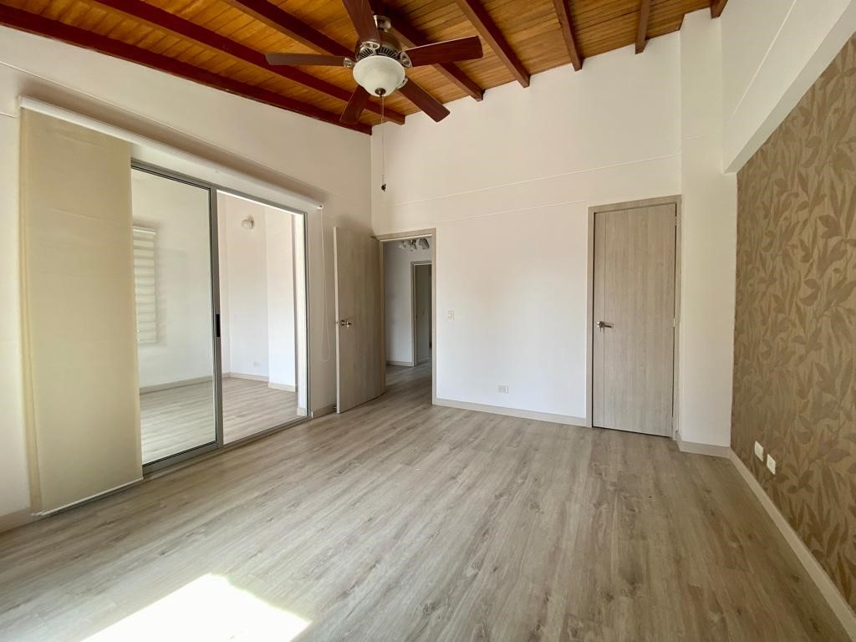
sAMPLE 183,000 USD
172 Qm, BEST SPOT, Medellín Poblado Estrato 6

Slide 16
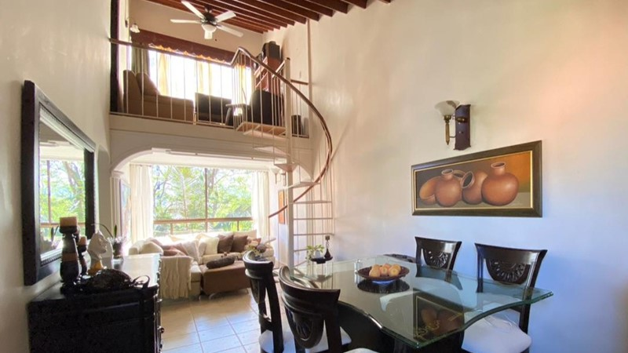
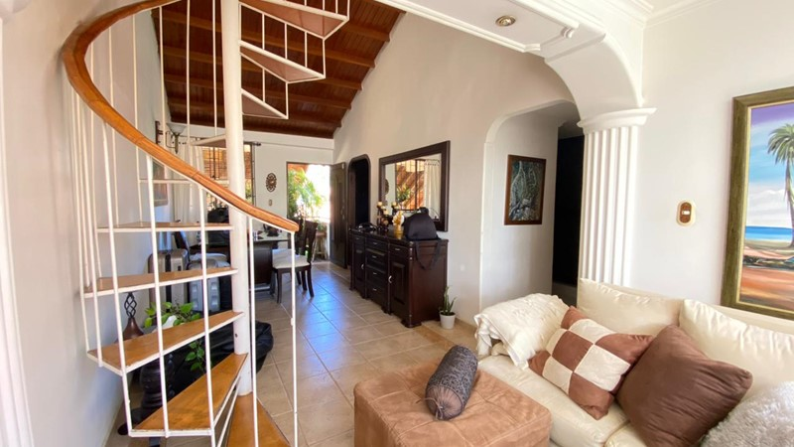
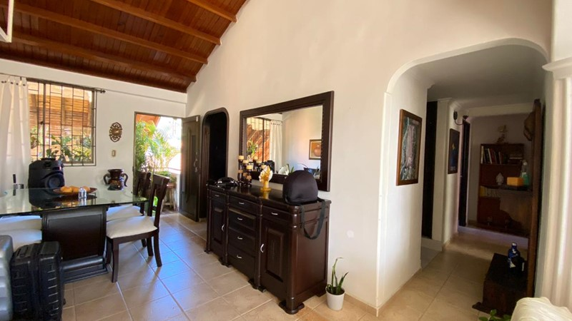
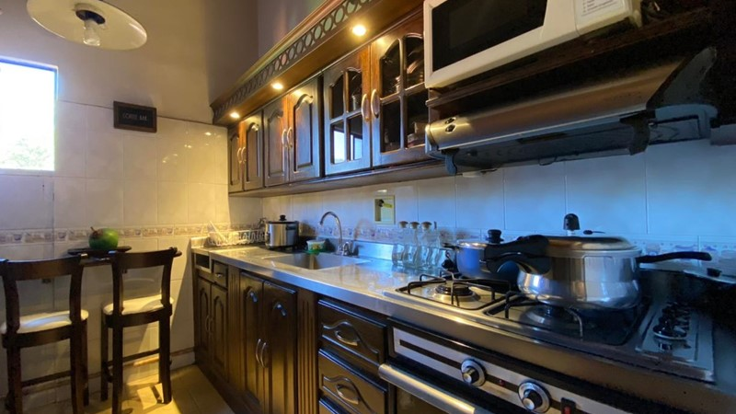
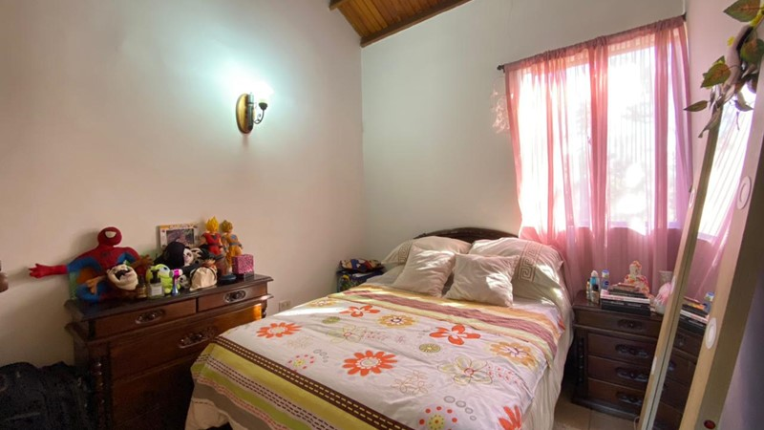
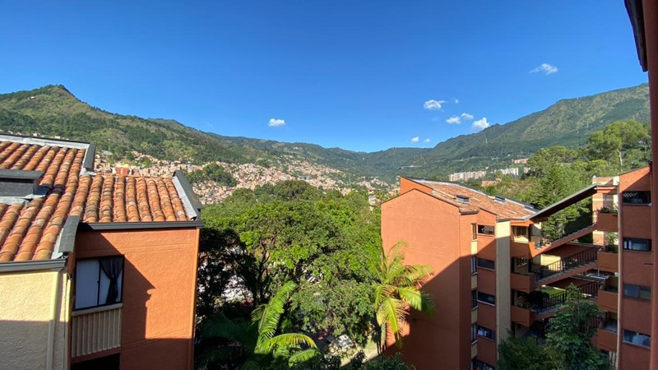
Sample 65,000 USD
96 Qm, intermidate spot; in Medellín Estrato 4

Slide 17
AUTARCHY SAS: MEDELLIN and santa marta
The company Autarchy SAS was founded in 2017 by Roger Schmidt (certified certified public accountant) from Basel, Switzerland. Together with his Colombian wife and lawyer, Autarchy gradually expanded its range of services. Autarchy currently employs 9 people (lawyers, auditors, assistants and secretaries).
Migrants receive comprehensive and competent advice – in German, English and Spanish. Autarchy covers all areas - visa applications, company formation, accounting, tax returns, health insurance, insurance and legal advice as well as real estate transactions, etc. - all from a single source. The focus is on individual and personal advice. Autarchy has a customer base of over 500 customers and a Google rating of 4.8 (5.0).
Since May 2023, Autarchy has also had a branch in Santa Marta. The company is also physically present for customers on the coast. Autarchy has its headquarters in Medellín (Envigado).
If anyone is interested in a tour of Colombia, we would be happy to advise them.
The homepage www.autarchy.co also publishes interesting news that is of interest to potential emigrants. So it's worth taking a look at our website again and again.
We look forward to hearing from you.

Slide 18
Conclusion
Colombia is an insider tip for emigrants. Many North Americans have discovered it for themselves, but more and more Europeans are also coming to the country.
Low costs of living and a very good infrastructure, coupled with the joy of life and the beautiful nature, make life here worth living.
We have set up a German-speaking regulars' table in Medellín and Santa Marta, so we meet in a relaxed atmosphere for pizza and beer and exchange our experiences and tips.
Whether tourist or expat, most people are positively surprised by Colombia. It's definitely worth checking out the Colombia option.
I myself am Swiss, have lived in Medellin since 2017 and have traveled the country intensively. Nothing serious has ever happened to me; I was neither robbed nor physically assaulted.
Of course, every emigrant also needs a certain relaxed attitude and openness. Colombia, like many other countries, cannot be compared with Germany or Switzerland. You need a little more patience and flexibility here - but if you have this, you have a good chance of finding your new home in Colombia. However, we recommend that everyone first visit the country of their “dreams” and then form their own opinion on site. We are happy to provide you with advice and assistance. We look forward to seeing you.

